Slide 1
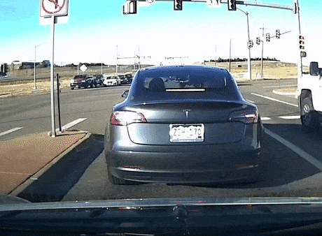
Driver’s Fault Prediction
ADTA-5340

Slide 2
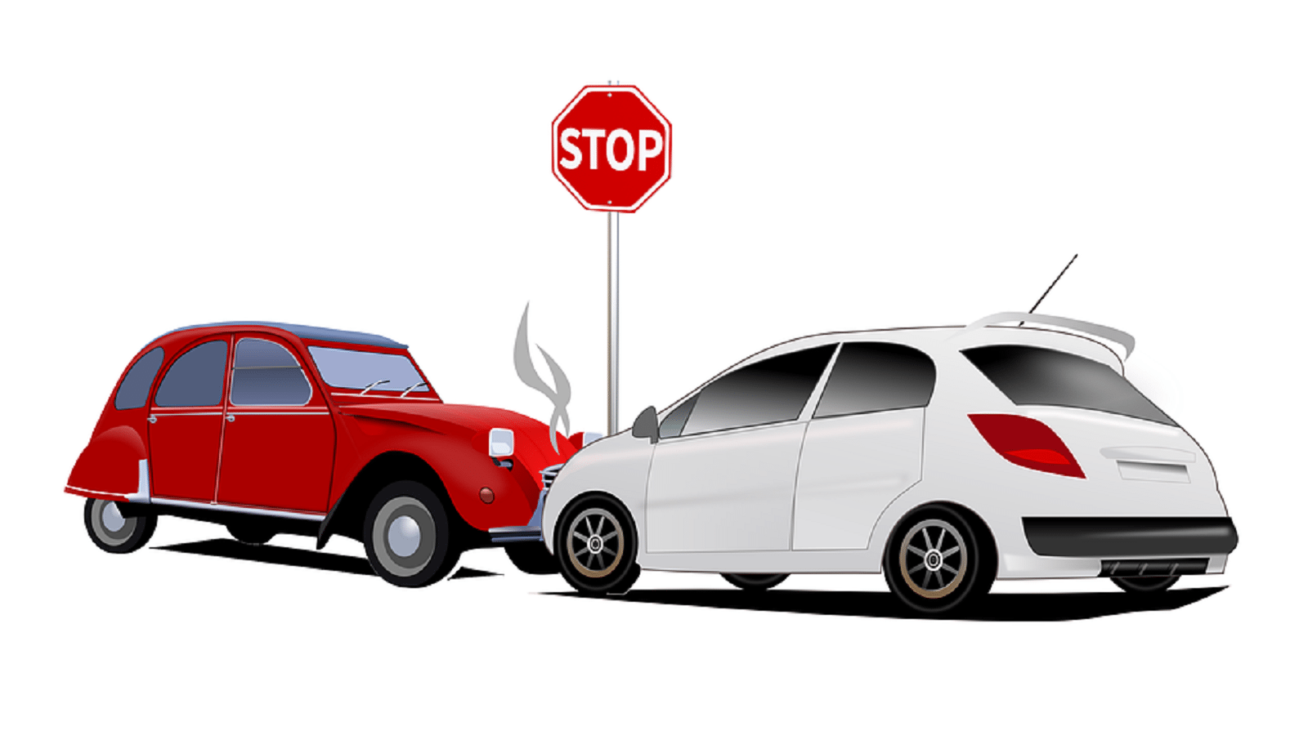
AGENDA
Introduction
How AI and ML are used
Problem to solve
Dataset Explanation
Data Preparation
EDA
Algorithm Used
Algorithm Comparison
Prediction
How does this help

Slide 3

INTRODUCTION
Car crash – Serious concerns?
Factors that lead to car crashes?

Slide 4
Use Case
Predicting whether the driver at fault when the crash occurred.

Slide 5
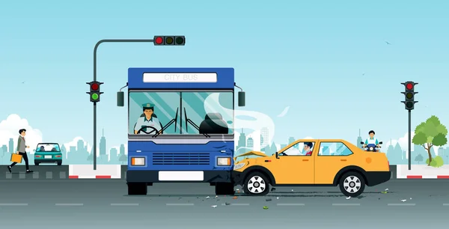
How AI and ML are used
1
2
3
Predictive modeling
Autonomous Vehicles
Driver Assistance System

Slide 6
Problem To Solve
Predicting whether the driver is at fault by considering these factors –
ACRS Report Type
Collision Type
Weather
Surface Condition
Light
Driver Substance Abuse
Injury Severity
Speed Limit
Vehicle Damage Extent
Vehicle Body Type

Slide 7
Dataset Explanation
The data is downloaded from data.gov: https://catalog.data.gov/dataset/crash-reporting-drivers-data
The data set consists of 43 columns and 157841 rows.
Important Independent Variables:
‘ACRS Report Type’, 'Collision Type’, 'Weather’, 'Surface Condition’, 'Light’, 'Driver Substance Abuse’, 'Injury Severity’, 'Speed Limit’, 'Vehicle Damage Extent’, 'Vehicle Body Type’.
Target Variable: ‘Driver At Fault’

Slide 8
Data Preparation
Crash reporting Dataset
Data Preprocessing
Exploratory data analysis
Logistic Regression
Prediction and Evaluation
Hyperparameter Tuning

Slide 9
Data Preparation
Data loading
Finding for missing values and handling
Dropping unnecessary columns
Label encoding
Algorithm
(Accuracy)
Normalization
Finding Correlation
EDA
Finding unique categorical values
Hyperparameter Tuning
Comparison

Slide 10
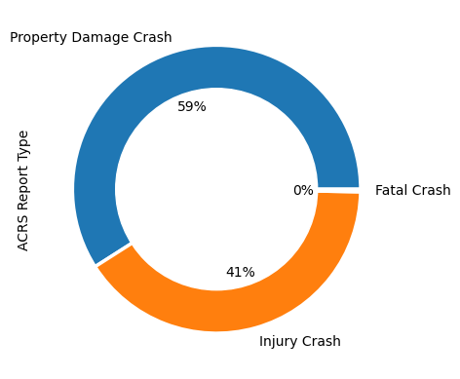
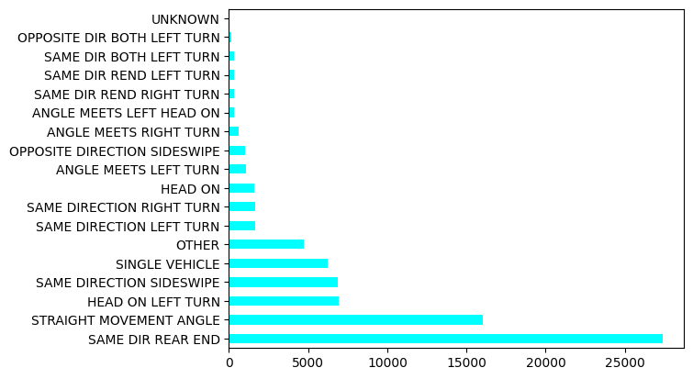
Exploratory Data Analysis
ACRS Report Type
Collision Type

Slide 11
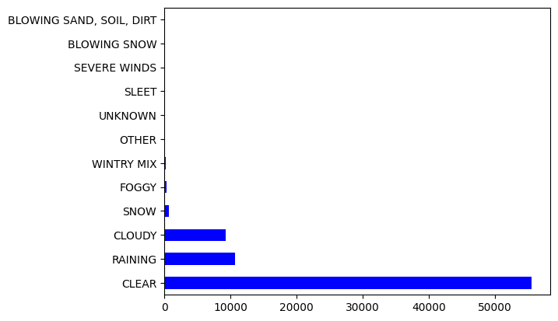
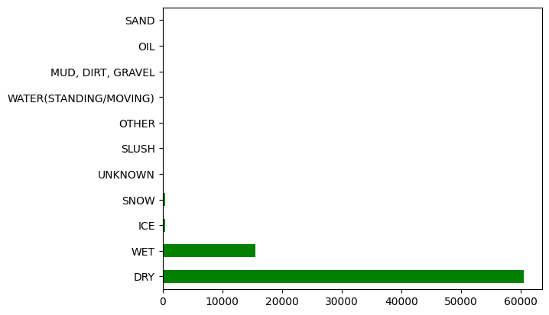
Exploratory Data Analysis
Weather
Surface Condition

Slide 12
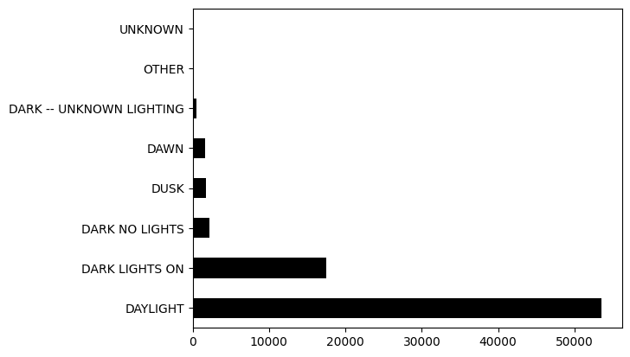
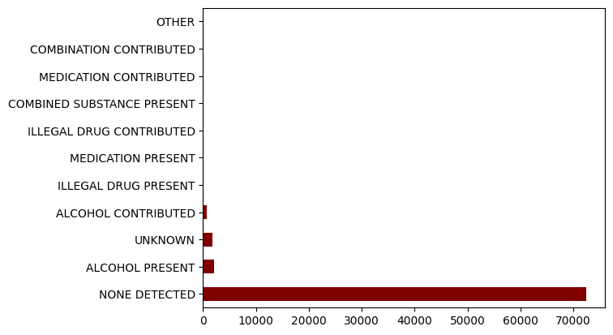
Exploratory Data Analysis
Light
Driver Substance Abuse

Slide 13
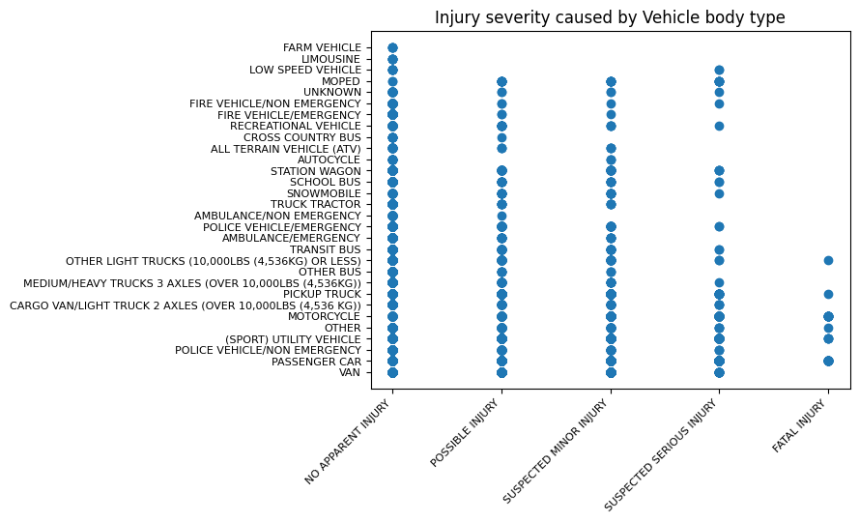
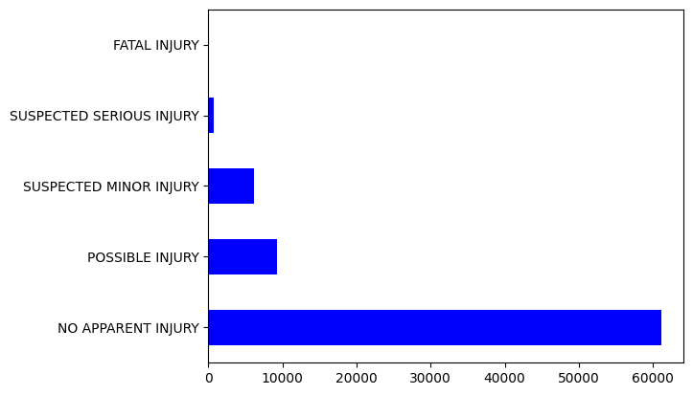
Exploratory Data Analysis
Injury Severity
Injury severity Caused by Vehicle body type

Slide 14
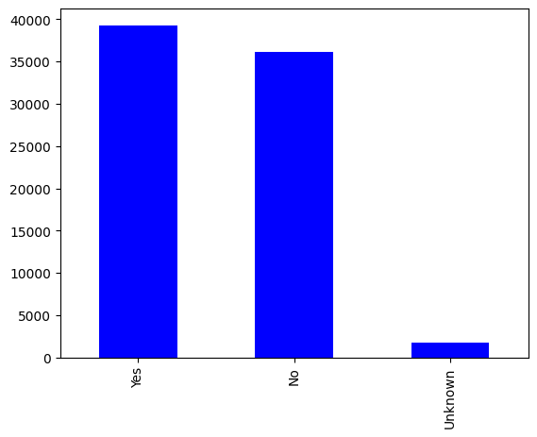
Exploratory Data Analysis
Driver at Fault

Slide 15
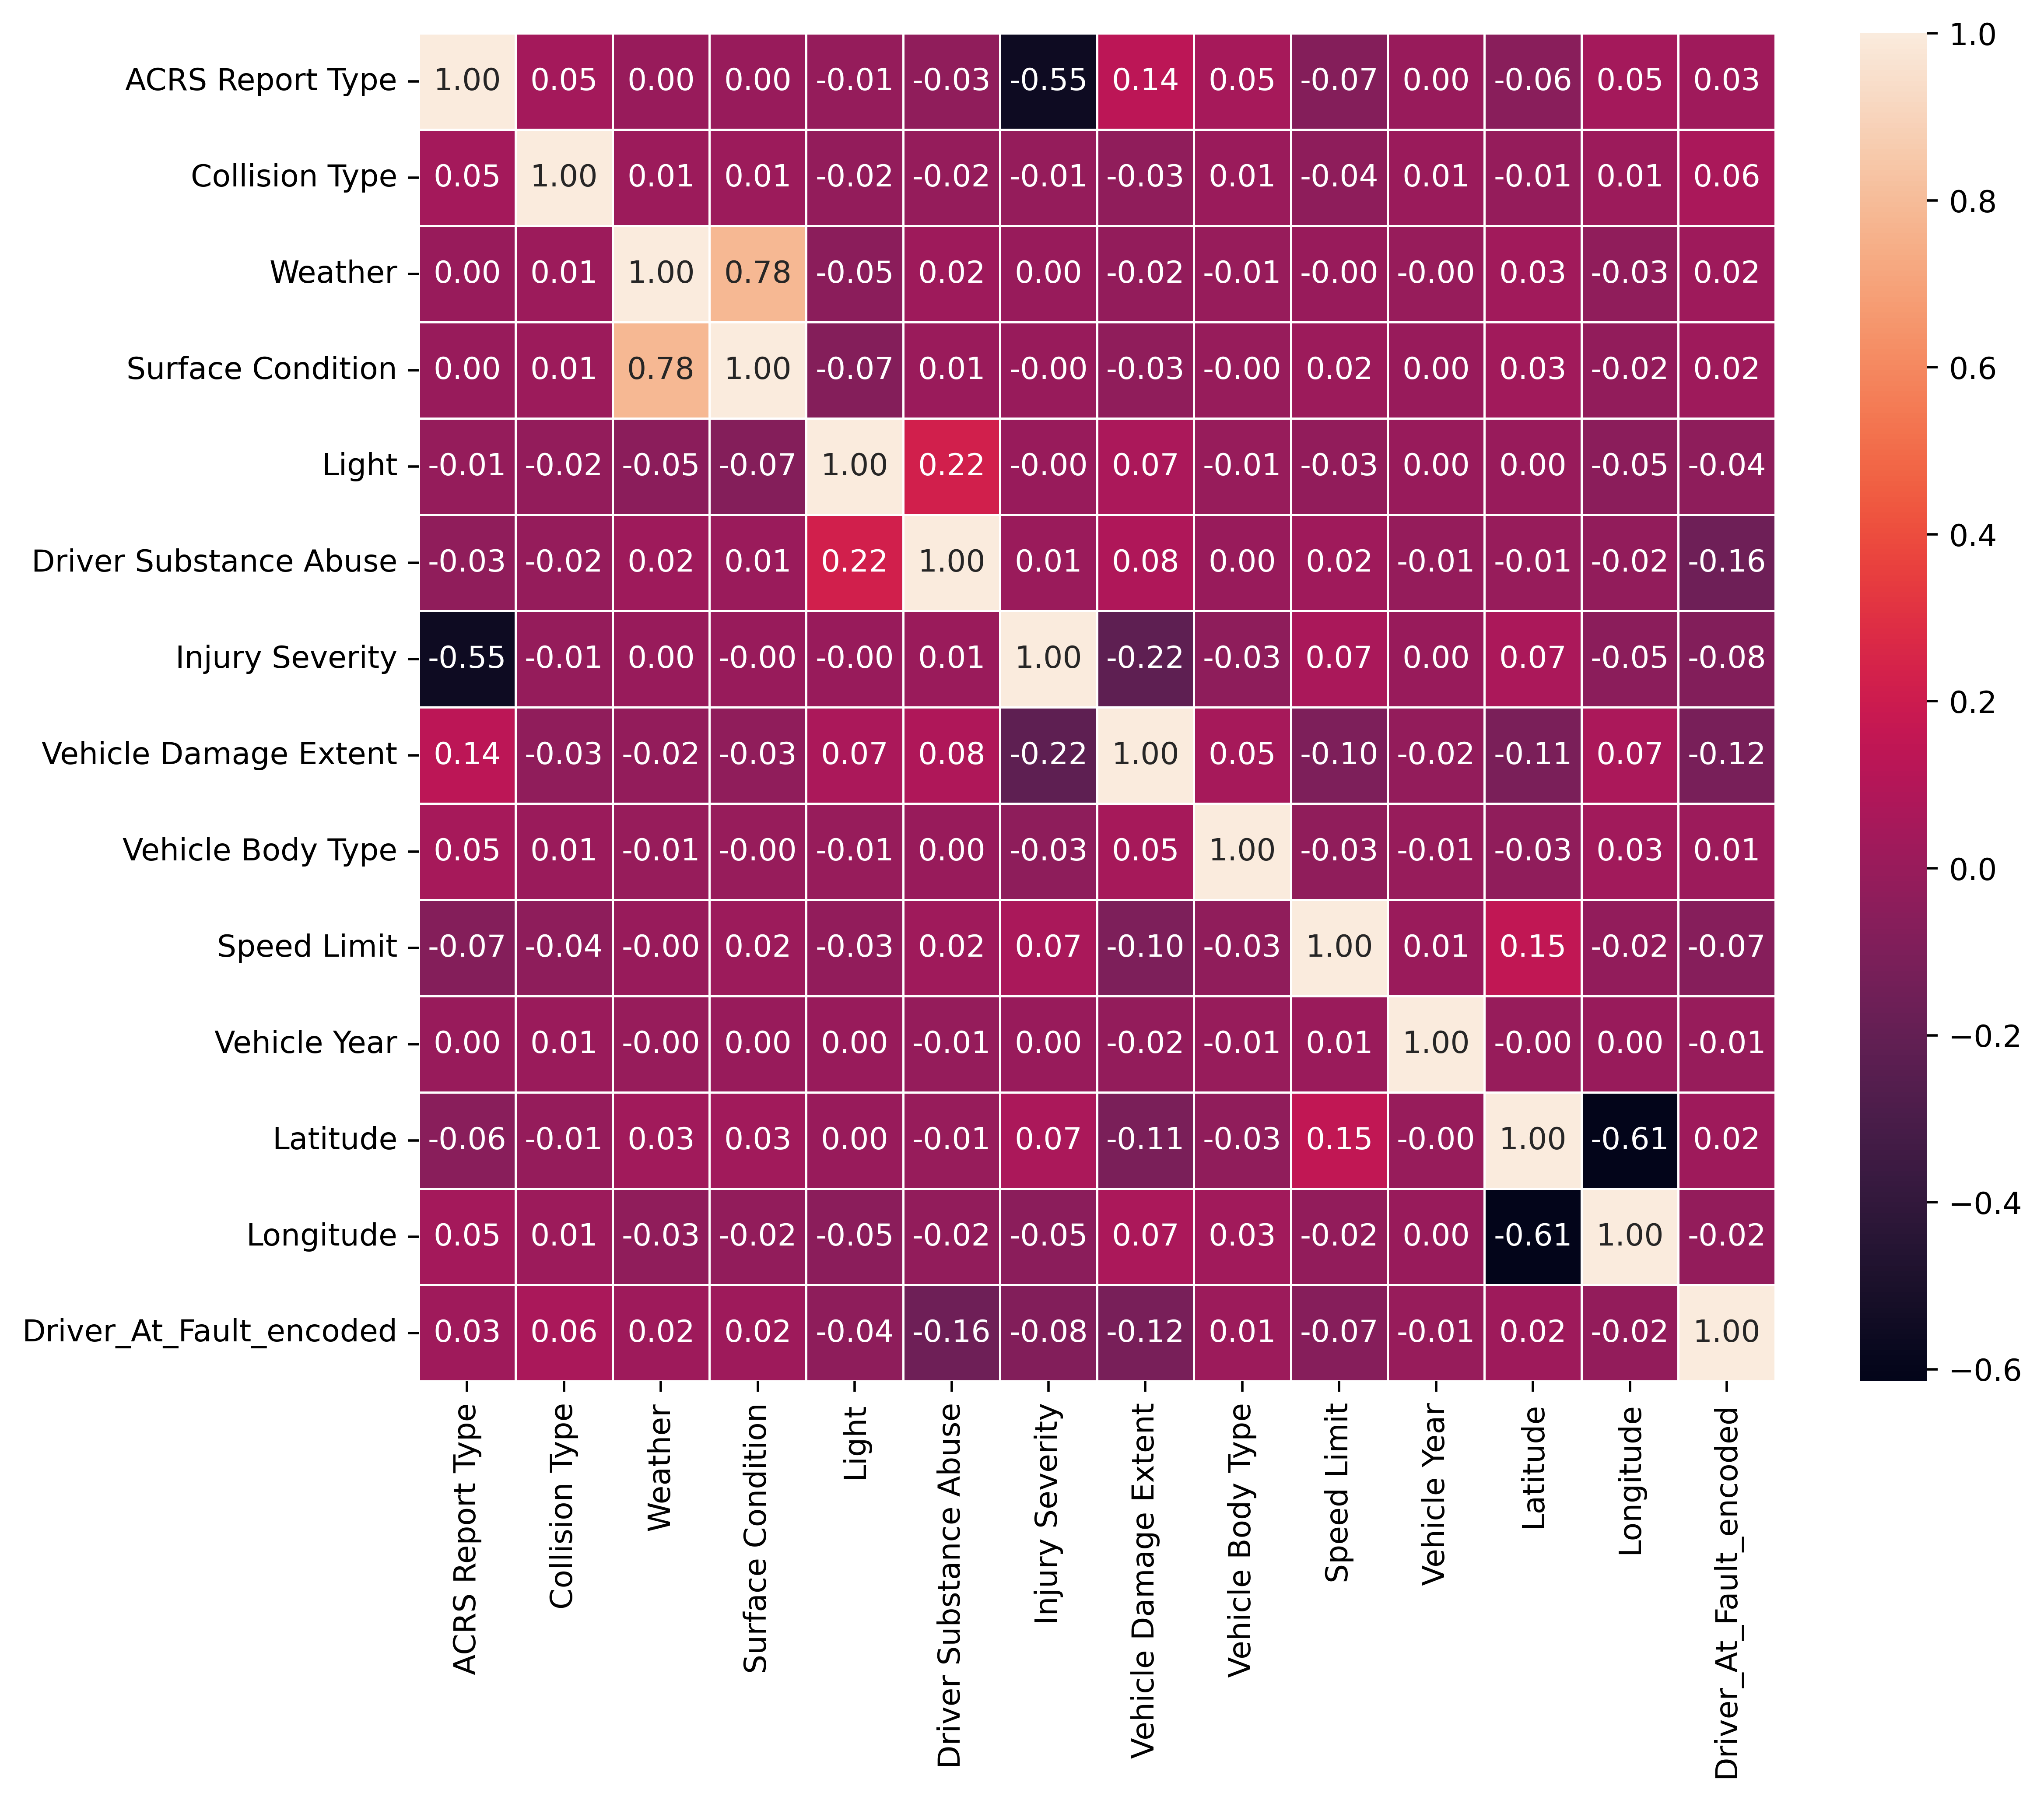
EDA
Correlation

Slide 16
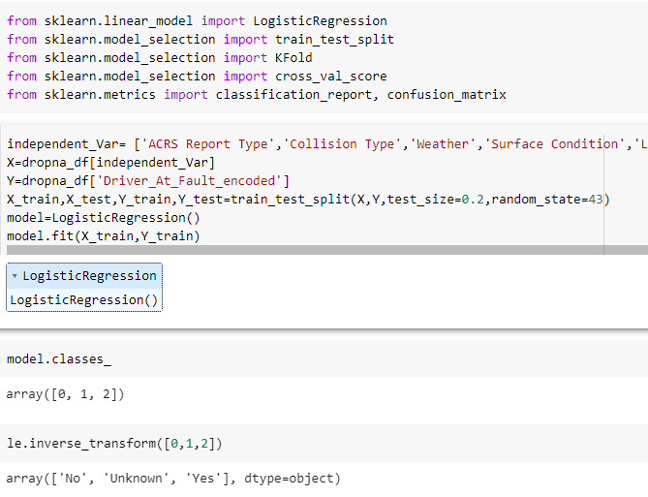
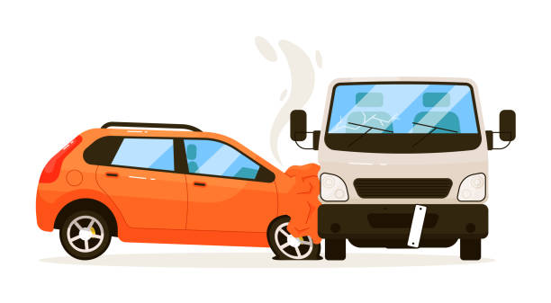
Algorithm Used

Slide 17
Comparison
Model | Accuracy
Logistic Regression | 57.62%
Logistic Regression with normalization | 57.67%
Logistic Regression with tuning (GridsearchCV) | 57.39%
Logistic Regression with Cross validation | 57.20%

Slide 18
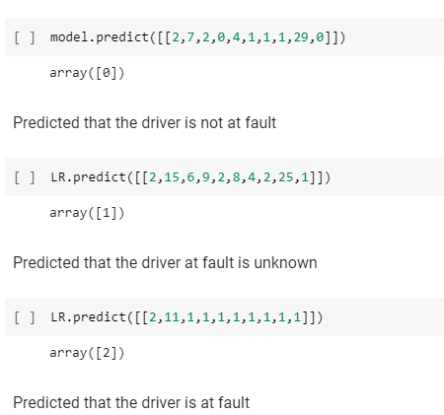
Predictions

Slide 19
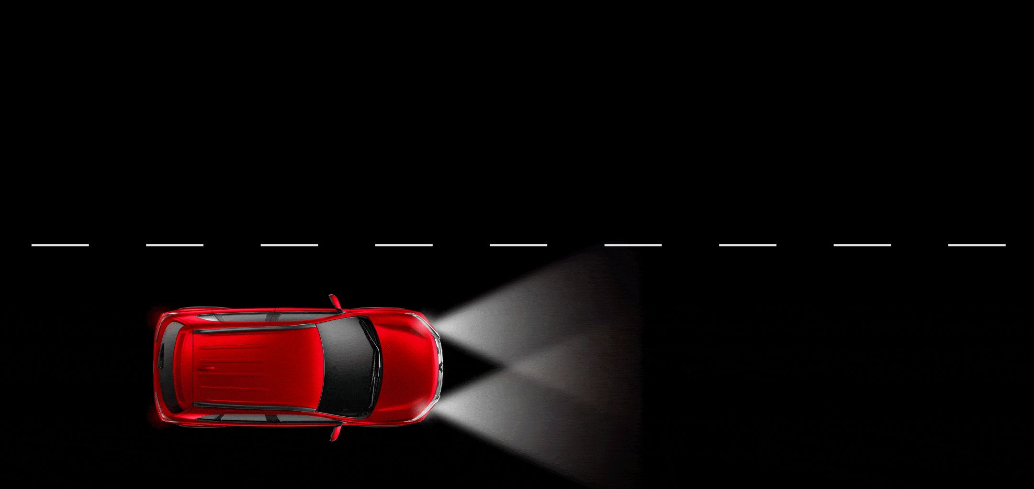
How it this helpful in real-time
Immediate response
Accident investigation
Safety improvements

Slide 20

Rewrite the Use-case
Predicting whether the driver at fault when the crash occurred without any discrimination and no violation of driver’s personal information.

Slide 21
References:
Crash Reporting - Drivers Data. (2023, April 21). Data.gov; data.montgomerycountymd.gov. https://catalog.data.gov/dataset/crash-reporting-drivers-data
wicked. (2020, August 14). Tesla saved by autopilot - Other car and truck not so lucky. https://www.reddit.com/r/gifs/comments/i9v2ro/tesla_saved_by_autopilot_other_car_and_truck_not/
Avertissement de redirection. (2023). Google.com. https://www.google.com/url?sa=i&url=https%3A%2F%2Fdepositphotos.com%2Fvector-images%2Ftraffic-accident-cartoon.html&psig=AOvVaw3RwCMBG9XKq6ziplBBKpWw&ust=1682662650709000&source=images&cd=vfe&ved=0CBIQjhxqFwoTCOCuxdu_yv4CFQAAAAAdAAAAABAE
Avertissement de redirection. (2023). Google.com. https://www.google.com/url?sa=i&url=https%3A%2F%2Fjimglaserlaw.com%2Fproving-fault-in-an-accident-claim-in-massachusetts%2F&psig=AOvVaw3RwCMBG9XKq6ziplBBKpWw&ust=1682662650709000&source=images&cd=vfe&ved=0CBIQjhxqFwoTCOCuxdu_yv4CFQAAAAAdAAAAABAJ

Slide 22
THANK YOU

